Slide 1


Basics of Data Structures
ETCCBD201
Ms. Jyoti Yadav
Faculty
School of Engineering & Technology
K.R. Mangalam University
Unit 2 : Linear Data Structures

Slide 2

Unit-2 Linear Data Structures
SESSION 11 Arrays – 1D & 2D
SESSION 12 Static & Dynamic Arrays
SESSION 13 Linked Lists Types
SESSION 14 Linked List Operations
SESSION 15 Stack ADT & Operations
SESSION 16 Stack Applications
SESSION 17 Queue ADT
SESSION 18 Queue Applications
SESSION 19 BFS using Queue
SESSION 20 Revision (Unit–2)
Notes:
New Courses replaced with New Programmes

Slide 3
Static and Dynamic Arrays
Session 12
Introduction to Arrays
Recapitulation: 1-D and 2-D Arrays
Classification of Arrays
Static Arrays
Dynamic Arrays
Advantages and Limitations
Static vs Dynamic Arrays (Comparison)
Memory Representation of Static and Dynamic Arrays
Real-World Applications
Practice Questions
Key Takeaways
Quick Quiz
References
Notes:
New Courses replaced with New Programmes

Slide 4
Learning Objectives
After this lecture, students will be able to:
Define static arrays and dynamic arrays
Explain memory allocation for both
Differentiate between static and dynamic arrays
Write programs using static and dynamic arrays
Decide when to use which type of array
Notes:
New Courses replaced with New Programmes

Slide 5
Recapitulation (Unit-2: 1-D Array)
Arrays: An array is a linear data structure that stores elements of the same data type
Elements are stored in contiguous memory locations
Each element is accessed using an index (starts from 0)
Why Arrays are Used
Efficient storage of multiple values under one name
Random access using index
Simplifies repetitive operations using loops
Improves code organization and readability
1-D Arrays
Store elements in a single row (linear form)
Declaration, initialization, and traversal using loops
Common operations:
Traversal
Sum of elements
Searching elements
Notes:
New Courses replaced with New Programmes

Slide 6
Recapitulation (Unit-2: 2-D Array)
Two-Dimensional Arrays (2-D Arrays)
Also called an array of arrays
Data stored in rows and columns
Index format: array[row][column]
Used to represent tables, matrices, grids
Traversal of 2-D Arrays
Uses nested loops
Outer loop → rows
Inner loop → columns
Memory Representation
Stored row-wise in memory
Correct indexing avoids logical and runtime errors
Notes:
New Courses replaced with New Programmes

Slide 7
Recapitulation
Q1. What is an array?
a) A non-linear data structure b) A collection of elements of different types c) A collection of elements of the same type stored contiguously d) A dynamic data structure
Q2. What is the index of the first element in an array?
a) 1 b) -1 c) 0 d) Depends on compiler
Notes:
New Courses replaced with New Programmes

Slide 8
Recapitulation
Q3. Which of the following is true about arrays?
a) Arrays store elements of different data types b) Arrays grow automatically in size c) Arrays store elements in contiguous memory locations d) Arrays do not support indexing
Q4. How many indices are required to access an element in a 2-D array?
a) One b) Two c) Three d) Depends on data type
Notes:
New Courses replaced with New Programmes

Slide 9
Recapitulation
Q5. Which loop structure is commonly used to traverse a 2-D array?
a) Single loop b) While loop only c) Nested loops d) Recursion
Q6. What will happen if an invalid index is used while accessing an array element?
a) Correct value is returned b) Compiler error c) Runtime error or unexpected behavior d) Program terminates automatically
Notes:
New Courses replaced with New Programmes

Slide 10
Recapitulation
Quiz (Answers)
Q1: c) A collection of elements of the same type stored contiguously
Q2: c) 0
Q3: c) Arrays store elements in contiguous memory locations
Q4: b) Two
Q5: c) Nested loops
Q6: c) Runtime error or unexpected behavior
Notes:
New Courses replaced with New Programmes

Slide 11
What is an Array?
An array is a collection of elements of the same data type
Stored in contiguous memory
Accessed using index values
Index starts from 0
Example: int arr[5] = {10, 20, 30, 40, 50};
Notes:
New Courses replaced with New Programmes

Slide 12
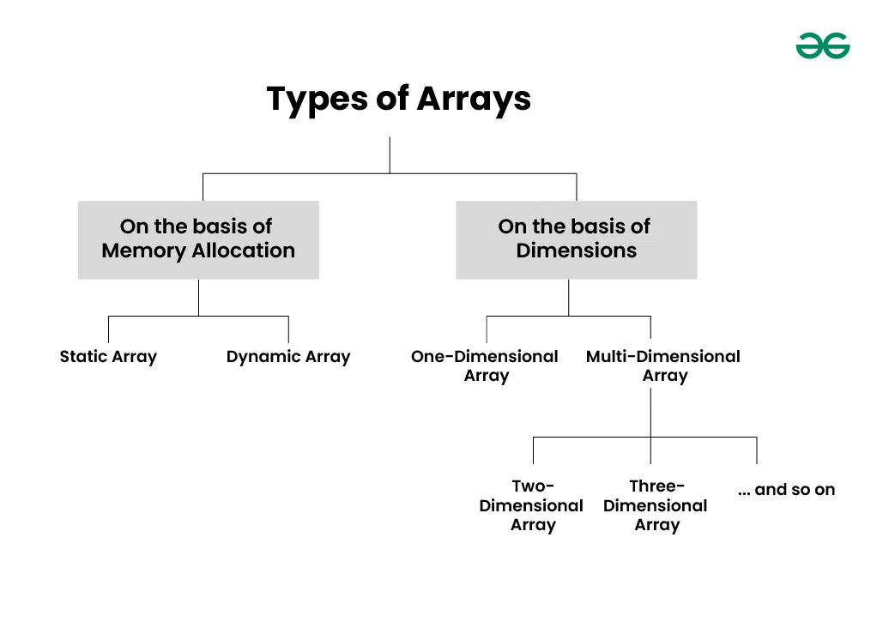
Classification of arrays
Arrays can be classified based on:
Size declaration (Dimensions)
Memory allocation time
Fig.1: Types of Arrays
Notes:
New Courses replaced with New Programmes

Slide 13
Static Arrays
Example: Fixed seating in a classroom
Memory allocated at compile time.
Array is of fixed size.
Size must be known before execution
Size cannot be changed later during program execution
Size in square brackets [ ].
Example:
int arr[5] = {1, 2, 3, 4, 5};
Notes:
New Courses replaced with New Programmes

Slide 14
Static Array – Example
Array Declaration and Initialization:
The array a is declared with a size of 3, which means it can store three integers. It is initialized with the values {10, 20, 30}.
Accessing an Element:
Array elements are accessed using index values starting from 0. The statement a[1] accesses the element at index 1, which is the second element of the array.
Output:
The printf statement prints the value stored at index 1 of the array, so the output displayed is 20.
#include <stdio.h>
int main() {
int a[3] = {10, 20, 30};
printf("%d", a[1]);
return 0;
}
Output:
20
Notes:
New Courses replaced with New Programmes

Slide 15
Static Array – Syntax and Initialization (Python)
 | Method-1 | Method-2 | Method-3
Syntax | arr = [0] * 5 | import array arr = array.array('i', [0, 0, 0, 0, 0]) | from typing import Final arr: Final = [1, 2, 3, 4, 5]
Initialization | arr = [10, 20, 30, 40, 50] | import array arr = array.array('i', [1, 2, 3, 4, 5])
Explanation | Size is decided at creation Index-based access Size is treated as fixed in logic Python allows resizing, but we do not resize it → behaves like static array | 'i' → integer type All elements must be of the same type | Indicates array should not be reassigned Used mainly for theoretical explanation
Notes:
New Courses replaced with New Programmes

Slide 16
Static Array – Syntax and Initialization (Python)
Feature | C Static Array | Python List (Static-like)
Size fixed | Yes | Treated as fixed
Memory | Stack | Heap
Type | Homogeneous | Heterogeneous (list)
Compile-Time | Yes | No
Note: Python does not have true static arrays, so we simulate a static array using a fixed-size list and do not resize it or array module can be used to simulate static array behavior.
Notes:
New Courses replaced with New Programmes

Slide 17
Example Program (Static Array Simulation in Python)
# Static array simulation in Python
arr = [10, 20, 30, 40, 50] # size fixed at creation
print("Static Array Elements:")
for i in range(5):
print(arr[i])
Output:
20
Array Declaration and Initialization:
The list arr is created with five elements [10, 20, 30, 40, 50]. Although Python lists are dynamic by nature, here the list size is treated as fixed, so it simulates a static array.
Accessing Elements Using a Loop:
A for loop runs from index 0 to 4 using range(5). In each iteration, the element at index i of the array is accessed using arr[i].
Output:
Each element of the array is printed one by one in order, resulting in the display of all values stored in the static array.
Key Points:
Size decided at creation
No append or resize operation used
Behaves like a static array conceptually
Notes:
New Courses replaced with New Programmes

Slide 18
Static Array – Memory Allocation
Memory allocated at compile time.
Usually stored in stack memory
Faster access
Limited flexibility
If array size is exceeded → memory wastage or overflow risk
Notes:
New Courses replaced with New Programmes

Slide 19
Static Array – Advantages & Limitations
Advantages:
Simple to declare and use
Fast access
Less overhead
Limitations:
Fixed size
Memory wastage possible
Not suitable when size is unknown
Notes:
New Courses replaced with New Programmes

Slide 20
Check Your Understanding
❓ Can the size of a static array be changed at runtime? ❓ What happens if the array size is exceeded?
Notes:
New Courses replaced with New Programmes

Slide 21
Check Your Understanding (Answers)
❓Can the size of a static array be changed at runtime? No, the size of a static array cannot be changed during runtime.
❓What happens if the array size is exceeded?
It may cause memory overflow or runtime errors, leading to unexpected behavior.
Notes:
New Courses replaced with New Programmes

Slide 22
Dynamic Arrays
Example: Expanding waiting list for admissions
Memory allocated at run time.
Array is not of fixed size.
Specify size during run time.
Stored in heap memory
Size can be modified using memory management functions.
Example:
int* arr = new int[5];
Notes:
New Courses replaced with New Programmes

Slide 23
Dynamic Array – Advantages & Limitations
Advantages:
Flexible size
Efficient memory utilization
Suitable for large data
Limitations:
Slower than static arrays
Memory leaks if not freed
More complex to manage
Notes:
New Courses replaced with New Programmes

Slide 24
Dynamic Array – Syntax
Dynamic Array Declaration: In both C and C++, the pointer arr is used to refer to a dynamically allocated array, allowing the array size to be decided at runtime.
Memory Allocation Using malloc() in C: The malloc() function allocates a contiguous block of memory sufficient to store n integers. The returned address is typecast to int* and stored in arr.
Memory Allocation Using new in C++: The new operator allocates memory for an array of n integers at runtime and returns the starting address, which is directly stored in the pointer arr.
Key Note: Memory allocated using malloc() must be released using free(), while memory allocated using new must be released using delete[] to avoid memory leaks.
Using malloc() in C:
int *arr;
arr = (int*)malloc(n * sizeof(int));
Using new in C++:
int *arr = new int[n];
Notes:
New Courses replaced with New Programmes

Slide 25
Dynamic Array – Example
Dynamic Array Declaration:
The variable n is set to 5, representing the number of elements. Memory for the array is dynamically allocated at runtime using malloc, which allocates space for 5 integers and returns a pointer stored in arr.
Initialization Using Loop:
A for loop iterates from index 0 to n−1. In each iteration, the value i * 10 is assigned to arr[i], initializing the dynamically allocated array elements.
Memory Deallocation:
After the array is used, the free(arr) statement releases the dynamically allocated memory back to the system, preventing memory leaks.
Program Termination:
The return 0; statement indicates successful termination of the program.
#include <stdio.h>
#include <stdlib.h>
int main() {
int n = 5;
int *arr = (int*)malloc(n * sizeof(int));
for(int i = 0; i < n; i++)
arr[i] = i * 10;
free(arr);
return 0;
}
Notes:
New Courses replaced with New Programmes

Slide 26
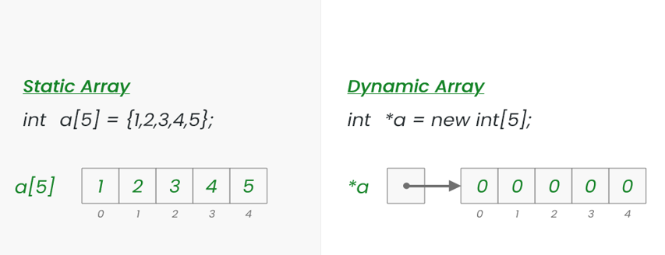
Example of Static and Dynamic Arrays
Fig.2: Example of Static and Dynamic Arrays
Notes:
New Courses replaced with New Programmes

Slide 27
Dynamic Array Using Python List
Syntax
arr = []
Initialization
arr = [10, 20, 30]
Adding Elements (Dynamic Growth)
arr.append(40)
arr.append(50)
Accessing Elements
print(arr[2]) # Output: 30
Notes:
New Courses replaced with New Programmes

Slide 28
Dynamic Array – Example
Example Program
arr = []
for i in range(5):
arr.append(i * 10)
print(arr)
Output:
[0, 10, 20, 30, 40]
Python automatically resizes memory when needed.
Python lists are dynamic arrays by default.
Dynamic Array Declaration:
An empty list arr is created. In Python, lists behave as dynamic arrays, meaning their size can grow at runtime.
Adding Elements Dynamically:
A for loop runs from 0 to 4. In each iteration, the value i * 10 is added to the list using the append() method, which automatically increases the size of the array.
Output:
After the loop completes, the print(arr) statement displays all the elements stored in the dynamic array, resulting in the output [0, 10, 20, 30, 40].
Notes:
New Courses replaced with New Programmes

Slide 29
Internal Working
Python list uses a dynamic resizing strategy
When capacity is full:
A larger memory block is allocated
Old elements are copied
Reference is updated
This makes the append operation amortized O(1)
Notes:
New Courses replaced with New Programmes

Slide 30
Dynamic Array Using array Module (Less Common)
Syntax
import array
arr = array.array('i')
Adding Elements
arr.append(10)
arr.append(20)
Homogeneous data only
Notes:
New Courses replaced with New Programmes

Slide 31
Comparison: Static vs Dynamic Array in Python
Feature | Static-like Array | Dynamic Array
Size | Fixed logically | Changes at runtime
Structure | List / array | List
Memory | Heap | Heap
Resize | Not allowed | Allowed
Flexibility | Low | High
Code Perspective
Initial size | Fixed | Zero
Resize allowed | No (by logic) | Yes
append() used | Avoided | Used
Flexibility | Low | High
Note: In Python, a dynamic array is implemented using lists, which automatically resize themselves when elements are added or removed during program execution.
Notes:
New Courses replaced with New Programmes

Slide 32
Static and Dynamic Array Memory Allocation
Static Array Memory Allocation
One contiguous block
Size fixed
No reallocation
Simple memory mapping:
[10] [20] [30] [40] [50]
Dynamic Array Memory Allocation
Starts with small capacity
When full → new larger block created
Old elements copied to new block
Reference updated:
Before resize: [10] [20] [30]
After resize : [10] [20] [30] [40] [50]
This resizing strategy gives amortized O(1) insertion.
Notes:
New Courses replaced with New Programmes

Slide 33
Check Your Understanding
❓Which Python data structure behaves as a dynamic array? ❓ What happens internally when a list grows beyond capacity?
❓ When to Use Dynamic Arrays?
Notes:
New Courses replaced with New Programmes

Slide 34
Check Your Understanding (Answers)
❓ Which Python data structure behaves as a dynamic array? Python list behaves as a dynamic array.
❓What happens internally when a list grows beyond capacity? Python allocates a larger memory block, copies existing elements to it, and updates the list reference, enabling amortized O(1) growth.
❓ When to Use Dynamic Arrays?
When input size is unknown
When frequent insertions are required
When memory flexibility is needed
Notes:
New Courses replaced with New Programmes

Slide 35
Dynamic Array (Resizable) in Python
# Dynamic array in Python
arr = [] # empty list (dynamic array)
for i in range(5):
arr.append(i * 10)
print("Dynamic Array Elements:")
for i in range(len(arr)):
print(arr[i])
Key Points:
Size changes at runtime
Memory grows automatically
append() triggers resizing if needed
Python lists are dynamic arrays by default.
Dynamic Array Declaration: An empty list arr is created. In Python, a list acts as a dynamic array, allowing its size to change during program execution.
Dynamic Insertion of Elements: The first for loop runs from 0 to 4. In each iteration, the value i * 10 is added to the list using the append() method, which dynamically increases the array size.
Accessing and Displaying Elements: The second for loop iterates from index 0 to len(arr) − 1. Each element of the dynamic array is accessed using its index and printed one by one.
Output: All elements stored in the dynamic array are displayed in sequence, showing how the array grows dynamically at runtime.
Notes:
New Courses replaced with New Programmes

Slide 36
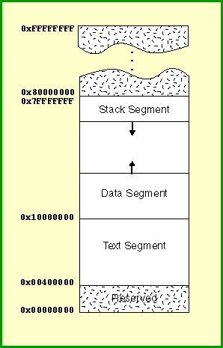
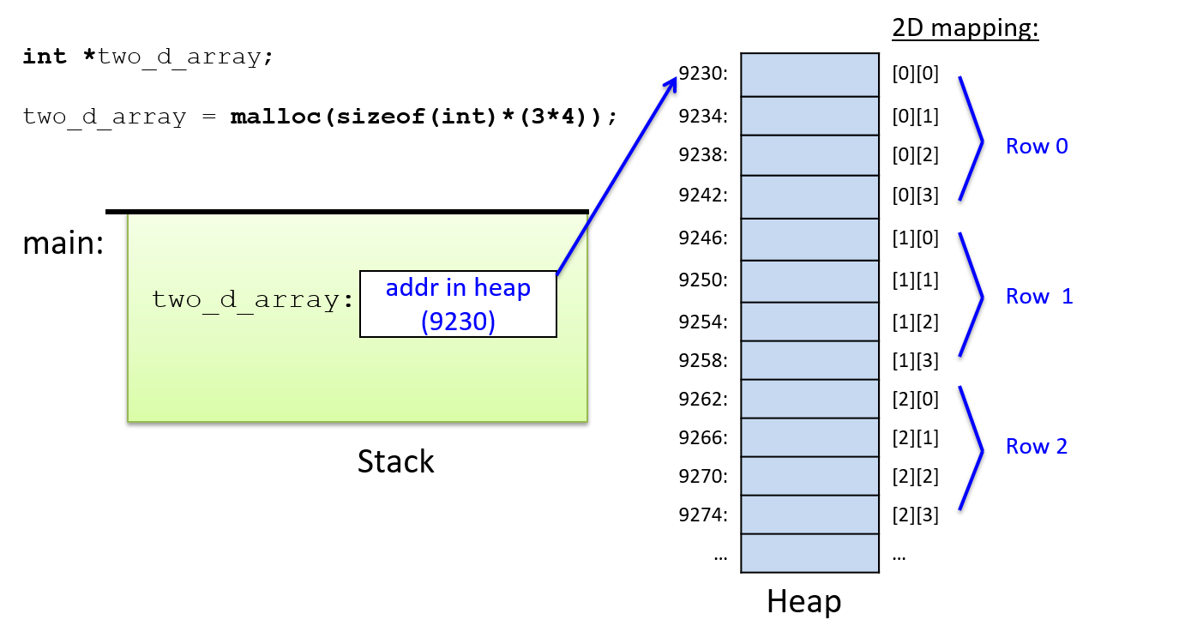
Visual Memory Representation
Fig.3 (a): Dynamic Arrays
Fig.3 (b): Static Arrays
Fig.3: Visual Memory Representation of Static and Dynamic Arrays
Notes:
New Courses replaced with New Programmes

Slide 37
Static vs Dynamic Arrays
Feature | Static Array | Dynamic Array
Size | Fixed | Variable
Allocation | Compile time | Runtime
Memory | Stack | Heap
Flexibility | Low | High
Performance | Faster | Slightly slower
Notes:
New Courses replaced with New Programmes

Slide 38
Practice Questions
Task:
Declare a static array of size 5
Convert the same program using a dynamic array
Identify the memory location used in both cases
Exercise:
Write a program to:
Accept array size from the user
Allocate memory dynamically
Store and display elements
Notes:
New Courses replaced with New Programmes

Slide 39
Practice Questions- Task – Answer
Declare a Static Array of Size 5
int arr[5] = {10, 20, 30, 40, 50};
Explanation: The array size is fixed at compile time and cannot be changed during execution.
Convert the Same Program Using a Dynamic Array
int *arr;
arr = (int*)malloc(5 * sizeof(int));
Explanation: Memory is allocated dynamically at runtime, allowing flexibility in array size.
Identify the Memory Location Used in Both Cases
Static Array: Stack memory
Dynamic Array: Heap memory
Notes:
New Courses replaced with New Programmes

Slide 40
Practice Questions- Task – Answer in Python
Declare a Static Array of Size 5 (Simulated in Python)
# Static array simulation in Python
arr = [10, 20, 30, 40, 50] # size fixed at creation
print(arr)
Explanation:
Python does not support true static arrays, so a fixed-size list is used and not resized, simulating static array behavior.
Notes:
New Courses replaced with New Programmes

Slide 41
Practice Questions- Task – Answer in Python
Convert the Same Program Using a Dynamic Array
arr = []
for i in range(5):
arr.append((i + 1) * 10)
print(arr)
Explanation: The list grows dynamically at runtime using the append() method.
Memory Location Used
Static array (simulated list): Heap memory
Dynamic array (list): Heap memory
Note: In Python, all lists are stored in heap memory.
Notes:
New Courses replaced with New Programmes

Slide 42
Practice Questions- Exercise – Answer
#include <stdio.h>
#include <stdlib.h>
int main() {
int n;
int *arr;
// Accept array size from the user
printf("Enter the size of the array: ");
scanf("%d", &n);
// Allocate memory dynamically
arr = (int*)malloc(n * sizeof(int));
// Store elements
printf("Enter %d elements:\n", n);
for(int i = 0; i < n; i++) {
scanf("%d", &arr[i]);
}
// Display elements
printf("Array elements are:\n");
for(int i = 0; i < n; i++) {
printf("%d ", arr[i]);
}
// Free allocated memory
free(arr);
return 0;
}
Notes:
New Courses replaced with New Programmes

Slide 43
Practice Questions- Exercise – Answer in Python
Program: Dynamic Array with User Input
# Dynamic array program in Python
n = int(input("Enter the size of the array: "))
arr = []
# Store elements
for i in range(n):
element = int(input(f"Enter element {i+1}: "))
arr.append(element)
# Display elements
print("Array elements are:")
for i in range(len(arr)):
print(arr[i])
Notes:
New Courses replaced with New Programmes

Slide 44
Static Array Applications
Used to store fixed exam marks when the number of subjects is known.
Used to represent days of the week or months of the year with a fixed size.
Used in game boards like chess or tic-tac-toe, where the board size is constant.
Used in embedded systems for fixed sensor readings due to limited memory.
Used for lookup tables such as ASCII codes or predefined constants.
Notes:
New Courses replaced with New Programmes

Slide 45
Dynamic Array Applications
Used in shopping carts where items can be added or removed dynamically.
Used in social media feeds where posts load and grow at runtime.
Used in student registration systems where the number of students is not fixed.
Used in image and video processing where data size varies dynamically.
Used in graph algorithms where adjacency lists grow based on input size.
Notes:
New Courses replaced with New Programmes

Slide 46
Key Takeaways
Static arrays are simple but rigid
Dynamic arrays are flexible but complex
Memory management is crucial in dynamic arrays
Choose wisely based on data size predictability
Notes:
New Courses replaced with New Programmes

Slide 47
Quick Quiz
Which memory is used by dynamic arrays?
Which array type is faster?
When should static arrays be preferred?
Notes:
New Courses replaced with New Programmes

Slide 48
Quick Quiz (Answers)
Which memory is used by dynamic arrays?
Dynamic arrays use heap memory.
Which array type is faster?
Static arrays are faster due to fixed size and compile-time memory allocation.
When should static arrays be preferred?
Static arrays should be preferred when the data size is fixed and known in advance.
Notes:
New Courses replaced with New Programmes

Slide 49
Quick Quiz
Fill in the Blanks
The memory used by static arrays is ________.
The Python data structure that behaves as a dynamic array is ________.
Dynamic arrays are stored in ________ memory.
Static arrays have a ________ size decided before execution.
The append() method is used to add elements in a ________ array in Python.
Dynamic memory allocated using malloc() should be released using ________.
Notes:
New Courses replaced with New Programmes

Slide 50
Quick Quiz (Answers)
Stack
List
Heap
Fixed
Dynamic
free()
Notes:
New Courses replaced with New Programmes

Slide 51
References
Textbooks
Cormen, T. H., Leiserson, C. E., Rivest, R. L., & Stein, C., Introduction to Algorithms, MIT Press.
Lipschutz, S., Schaum’s Outline of Data Structures with C++, McGraw-Hill Education.
Reference Books
Weiss, M. A., Data Structures and Algorithm Analysis in C++, 5th Edition, Pearson Education.
Skiena, S. S., The Algorithm Design Manual, 3rd Edition, Springer.
Online Resources
GeeksforGeeks – Arrays in Data Structures https://www.geeksforgeeks.org/array-data-structure/
TutorialsPoint – Data Structures: Arrays https://www.tutorialspoint.com/data_structures_algorithms/array_data_structure.htm
MIT OpenCourseWare – Introduction to Algorithms https://ocw.mit.edu
Programiz – Python Lists (Dynamic Arrays) https://www.programiz.com/python-programming/list
Notes:
New Courses replaced with New Programmes

Slide 52
THANK YOU

